Slide 1



Water Quality Monitoring using Random Forest
Discover how the Random Forest algorithm can be used to monitor water quality using various data parameters.
by Sharvaree Raut

Slide 2
Table of Contents
Introduction
Objective
Work Flow
Results and Analysis
Challenges Faced
Advantages
Applications
Conclusion
References
Thank You!

Slide 3

Introduction
Importance: Water quality monitoring plays a vital role in ensuring a safe water supply for communities.
Overview: In this project, we will explore the application of the Random Forest algorithm for water quality analysis.

Slide 4
Objective
To develop a robust water quality monitoring system using advanced machine learning techniques. We aim to improve the accuracy and efficiency of water quality analysis, enabling timely actions to be taken for ensuring a safe and sustainable water supply.

Slide 5

Work Flow
1
Data Collection and Preparation
Examine the dataset columns and implement data cleaning and preprocessing techniques.
Feature Selection and Engineering
2
Select relevant features and engineer new ones to improve the performance of the Random Forest model.
3
Model Development and Evaluation
Split the dataset, build the Random Forest model, and evaluate its performance.

Slide 6
Data Description
Index
Components :
'pH', 'Iron', 'Nitrate', 'Chloride', 'Lead', 'Zinc',
'Turbidity', 'Fluoride', 'Copper', 'Odor', 'Sulfate', 'Conductivity',
'Chlorine', 'Manganese', 'Total Dissolved Solids'
Sources
Temperature :
'Water Temperature', 'Air Temperature'
Color
Time :
'Month', 'Day', 'Time of Day'
Target

Slide 7
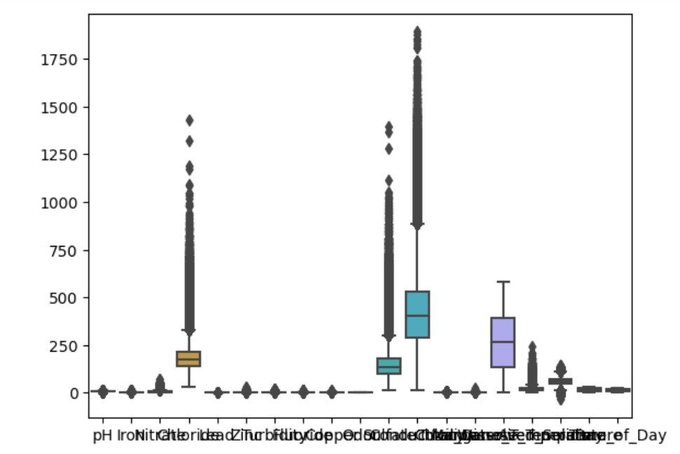
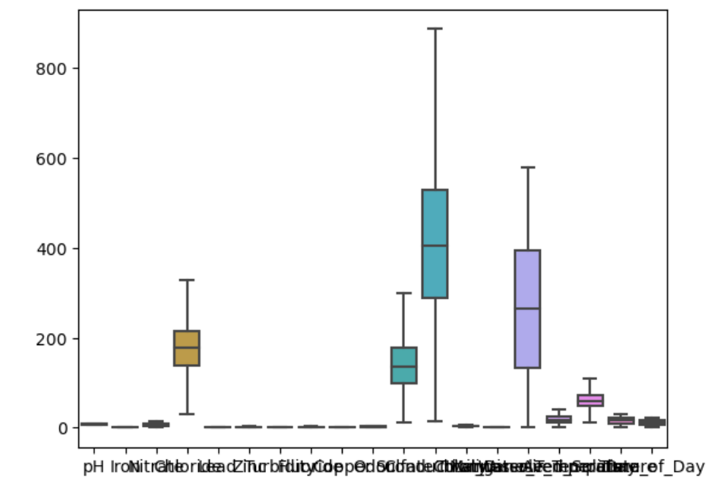
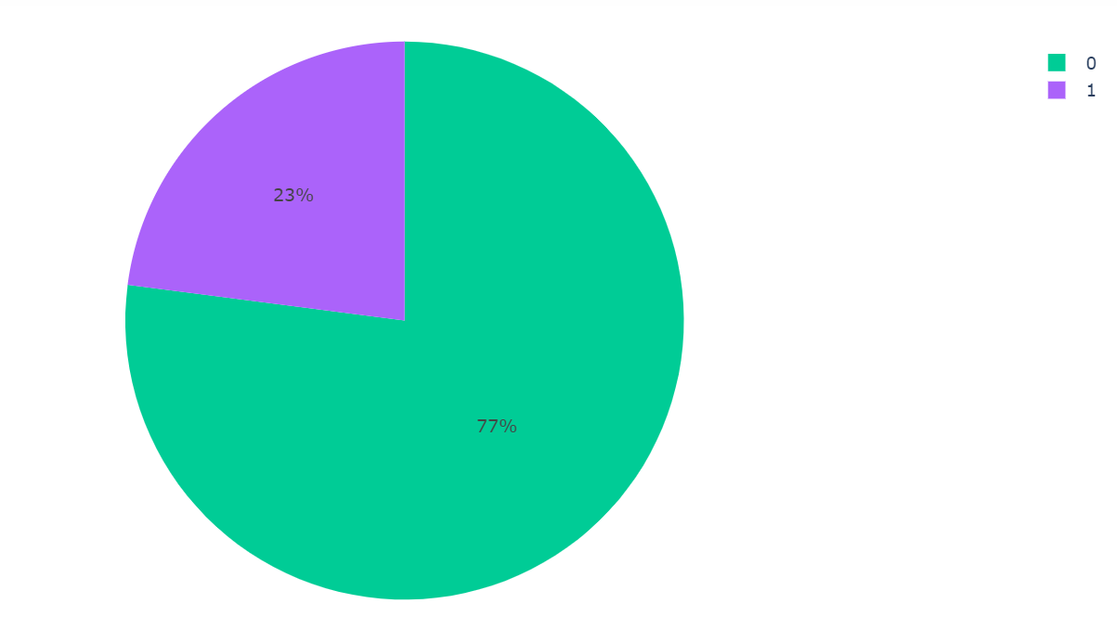
Data Pre-processing
Data Visualization

Slide 8
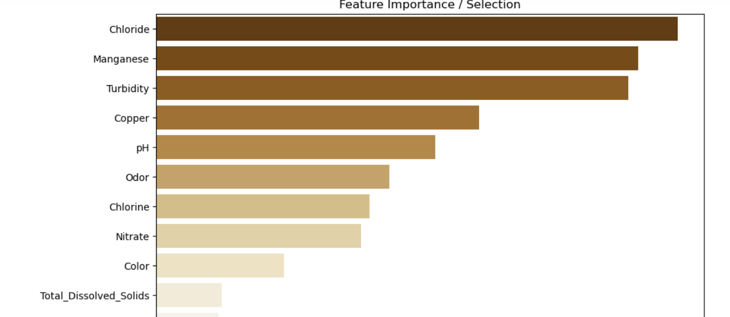
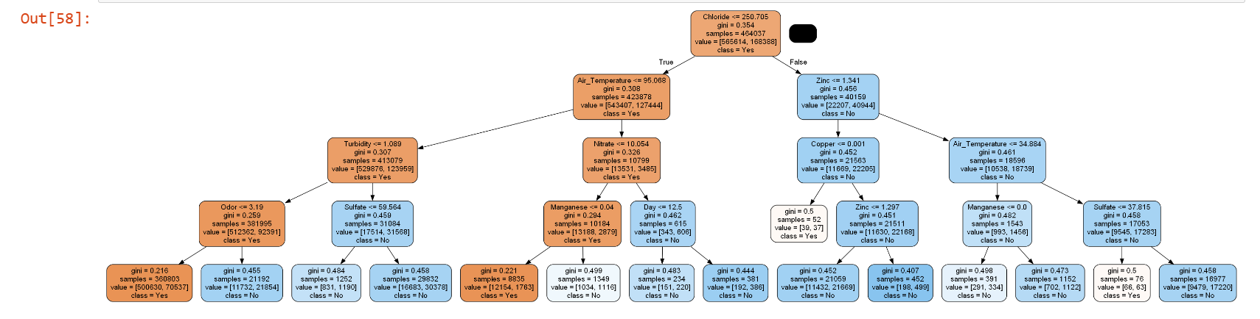
Important Features
Random Forest

Slide 9
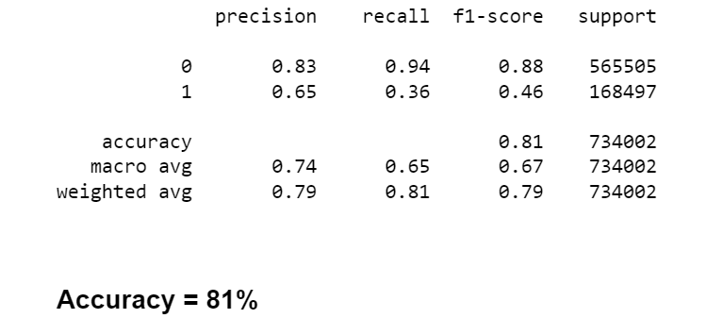
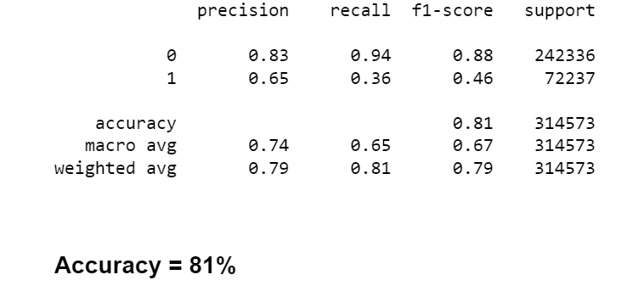
Train and Test Accuracy

Slide 10
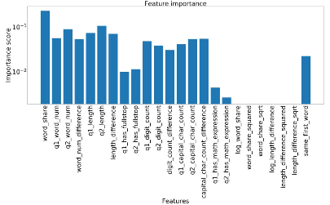
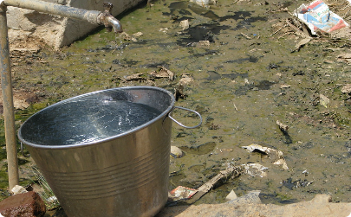

Results and Analysis
Interpreting Feature Importance
Impact of Each Variable
Potential Insights and Recommendations
Gain insights by analyzing the importance of different variables in predicting water quality.
Analyze the influence of individual variables in determining water quality.
Discuss actionable recommendations based on the analysis of water quality data.

Slide 11

Challenges Faced
Data Variability
Incomplete Data
Model Overfitting
Address the challenges posed by the variability of water quality data.
Tackle the issue of incomplete data and handle missing values.
Combat the risk of overfitting and optimize the Random Forest model's generalization ability.

Slide 12

Advantages
1
Accuracy
2
Robustness
Random Forest algorithm enhances accuracy in water quality prediction.
Explore the robustness of Random Forest in handling various types of water quality data.
3
Interpretability
Understand how the Random Forest model allows for the interpretation of water quality indicators.

Slide 13
Applications
Drinking Water Quality
Environmental Conservation
Industrial Processes
Monitor and predict the quality of drinking water to ensure safety and compliance.
Assess the impact of various factors on water quality to guide conservation efforts.
Facilitate monitoring and control of water quality in industrial processes for improved efficiency.

Slide 14

Summary
1
Model has Accuracy of 81%, Hence it accurately predicts the quality of Water
Key Findings and Conclusions
2
3
If the quality of Water is Bad, its a need to focus on enhancing nutrients content in water in balanced way and to purify water regularly
Need to reduce mixture of pollutants and other harmful substances in water that degrades its quality

Slide 15
Conclusion
Key Findings and Conclusions
Importance of Monitoring and Prediction
Future Research Directions
Summarize the key findings and conclusions derived from the Random Forest water quality analysis.
Suggest potential areas for future research and improvements in water quality monitoring.
Highlight the significance of continuous water quality monitoring and predictive modeling.

Slide 16
References
https://www.kaggle.com
Class notes

Slide 17

Thank You!

